Slide 1
Distributed Systems and Related Concepts
Overview of Distributed Systems
Models and Programming Paradigms
Network Programming
Security Options

Slide 2
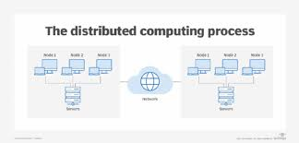
Distributed Systems Overview
Definition:
- A collection of independent computers appearing as a single coherent system.
Key Characteristics:
- Resource Sharing
- Scalability
- Fault Tolerance
- Transparency (Location, Replication, Concurrency)

Slide 3
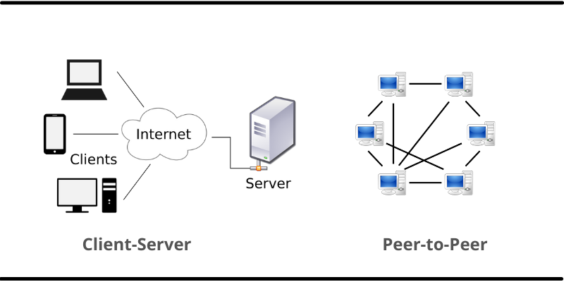
Distributed Systems Models
Architectural Models:
1. Client-Server Model (e.g., Web applications)
2. Peer-to-Peer Model (e.g., Blockchain)
Interaction Models:
- Synchronous vs. Asynchronous Systems
Failure Models:
- Crash and Byzantine Failures
Security Models:
- Confidentiality, Integrity, Availability

Slide 4
Case Studies for Models
Netflix (Client-Server Model):
- Clients request videos from servers.
Bitcoin (Peer-to-Peer Model):
- Decentralized transaction validation.

Slide 5
Parallel and Distributed Programming Paradigm
Definitions:
Parallel Programming:
Tasks run simultaneously on multiple processors.
Distributed Programming:
Tasks distributed across multiple computers.
Key Concepts:
- Parallelism vs. Concurrency
- Task and Data Parallelism

Slide 6
Models for Programming
Parallel Programming Models:
1. Shared Memory Model (e.g., Multi-threading in Java)
2. Distributed Memory Model (e.g., MPI)
Distributed Programming Frameworks:
- Apache Spark
- Hadoop/MapReduce

Slide 7
Case Study: Google MapReduce
Problem:
- Processing terabytes of data.
Solution:
- Splitting data into chunks processed in parallel.

Slide 8
Network Programming
Definition:
- Writing programs that communicate across networks.
Core Concepts:
1. Socket Programming (TCP and UDP)
2. Protocols (TCP/IP, WebSocket)
3. Middleware (CORBA, gRPC)

Slide 9
Example of Network Programming
Building a Simple HTTP Server:
- Using Python Flask library.
Real-world Application:
- WhatsApp WebSocket for messaging.

Slide 10
Security Options for Distributed Systems
Challenges:
- Unauthorized access
- Data breaches
- Malware attacks
Core Security Measures:
1. Authentication (e.g., OAuth 2.0)
2. Authorization (Role-Based Access Control)
3. Encryption (AES, RSA)
4. Firewalls and IDS

Slide 11
Case Study: Distributed Denial-of-Service (DDoS) Attack
Incident:
- 2016 Dyn DNS provider attack.
Impact:
- Affected Twitter, Netflix, and others.
Solution:
- Secure IoT devices and robust intrusion detection.

Slide 12
Summary
Key Takeaways:
- Models ensure distributed system efficiency and reliability.
- Programming paradigms utilize resources better.
- Security builds trust in distributed systems.
Questions?

